Slide 1
Class 2: monopoly
ECN 100B – Intermediate Microeconomics
Spring 2025
Prof. Muehlegger

Slide 2
Announcements
Office hours start this week. Please see the discussion item on Canvas for times / locations.
Problem Set 1 is posted. It is due next Tuesday.
The first weekly quiz will happen tomorrow.
Five multiple choice questions, 10 minutes.
Anytime between 12am – 11:59pm.
It is open-book, open-note, but not “open-friend” nor “open-AI”

Slide 3
Class Outline
What is a monopoly?
Monopoly profit maximization
Welfare under Monopoly

Slide 4
Recap from last class
The perfectly competitive market maximizes welfare.
There is no deadweight loss and in the long-run, firms produce at the minimum of their average cost curves.
But, if the market is not perfectly competitive, the market might not maximize welfare.
We begin to explore the first of these today by discussing monopoly.

Slide 5
I. What is a monopoly?

Slide 6
What is a monopoly?
A monopoly is a sole supplier of a good that has not close substitute.
There many historical (and contemporary) examples of monopolies.
Historical: Hudson Bay Company, British East India Company, US Steel, Aluminum Company of America (ALCOA)
Modern: Many utilities (e.g., PGE), firms with patents (e.g., Pfizer)

Slide 7
What are the assumptions of monopoly?
There is a single firm.
The firm sets a single price for all customers.
Barriers to entry exist
These assumptions lead monopolies to behave differently than perfectly competitive markets.
A monopoly is not a price-taker. The production decision of a monopoly affects the market price.
If barriers to entry exist, a monopoly can earn economic profits in the long-run.

Slide 8
Are monopolies good or bad from a welfare perspective?
Good
Bad
It depends
I don’t know
100B – A: https://join.iclicker.com/HTCC
100B – B: https://join.iclicker.com/MZWB

Slide 9
How can a monopoly arise? (Perloff 11.4)
Cost advantage: A single firm can serve the market at lower cost
Government creation: The government creates the monopoly with a patent (e.g., pharmaceuticals) or a license (e.g. liquor stores)
Network Externalities: The value of the good / service depends on how many consumers use the good (e.g., Google Search)
Anticompetitive conduct that prevents competitors from entering
Mergers
Firm coordination / Cartels
Notes:
Note here that 1 – 3 are reasons why we might like a monopoly. 4 – 6 are reasons why we might not like a monopoly.

Slide 10
II. Monopoly profit maximization (Perloff 11.1)

Slide 11
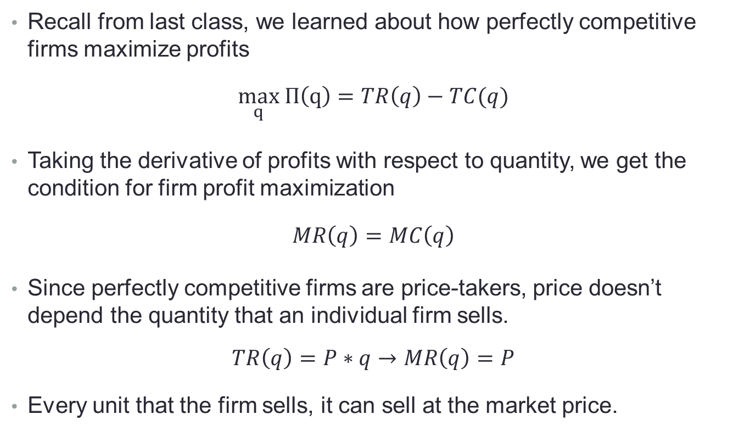
Marginal revenue for perfect competition
Recall from last class, we learned about how perfectly competitive firms maximize profits
$$\max_{q} Π\left(q\right)=TR\left(q\right)−TC(q)$$
Taking the derivative of profits with respect to quantity, we get the condition for firm profit maximization
$$MR\left(q\right)=MC\left(q\right)$$
Since perfectly competitive firms are price-takers, price doesn’t depend the quantity that an individual firm sells.
$$TR\left(q\right)=P∗q→MR\left(q\right)=P$$
Every unit that the firm sells, it can sell at the market price.

Slide 12
Marginal revenue for perfect competition
Every unit that a perfectly competitive firm sells, it can sell at the market price → MR curve is horizontal.
Perfectly Competitive Firm
P
Demand curve
for PC firm
TR(q)
q
q

Slide 13
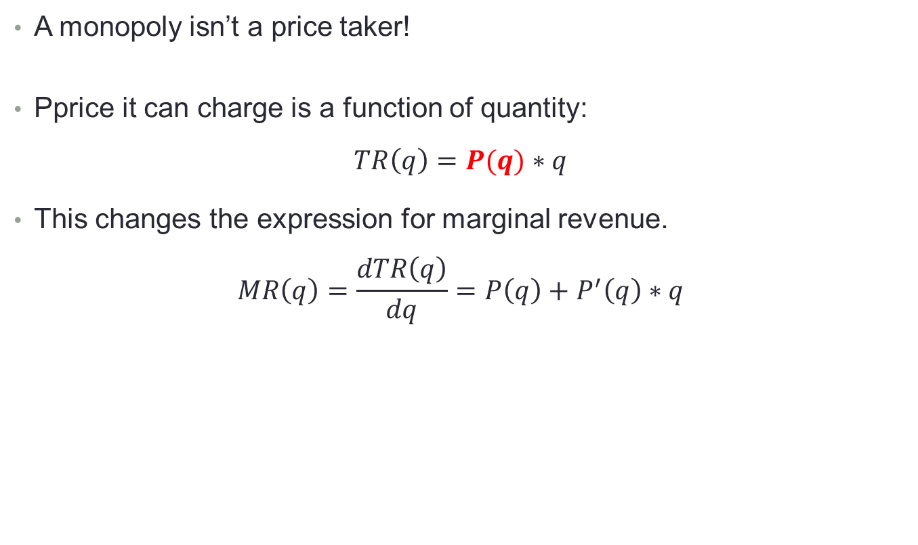
So what is different about a monopoly?
A monopoly isn’t a price taker!
Pprice it can charge is a function of quantity:
$$TR\left(q\right)=P(q)∗q$$
This changes the expression for marginal revenue.
$$MR\left(q\right)=\frac{dTR\left(q\right)}{dq}={P\left(q\right)+P}^{′}\left(q\right)∗q$$

Slide 14
Marginal revenue for monopoly
Higher production affects monopoly revenue in two ways.
Perfectly Competitive Firm
Monopoly
MR for a one unit
change in q
P
P
Demand curve
for PC firm
p₁
p₁
TR(q)
TR(q)
D
q
q+1
q
q
q
Notes:
Revenues are higher because the firm sells more units. (Region A)
But, the firm has to cut the price to sell more, so it loses revenue on units that would have sold at the higher price (Region B)
Region A (green): P
Region B (red): P’(q)*q

Slide 15

A numerical example clearly shows the two regions A and B.
Let’s consider an example where the market demand curve is given by $P=80 −q$.
Region A: New revenue from selling one more unit.
Region B: Lost revenue from having to lower price on other units.
Quantity | Price | TR | MR | Region A: P(q) | Region B: P’(q)*q
10 | 70 | 700
11 | 69 | 759
12 | 68 | 816
13 | 67 | 871
14 | 66 | 924
15 | 65 | 975

Slide 16

Profit maximization for monopoly
Does a monopoly maximize profits like a perfectly competitive firm?
Yes! Like a perfectly competitive firm, a monopoly maximizes profit at the point where MR = MC.
$$\max_{q} Π\left(q\right)=TR\left(q\right)−TC\left(q\right)→MR\left(q\right)=MC\left(q\right)$$

Slide 17
We can find the profit maximizing decision for the monopolist two ways.
We can find the profit maximizing output in three steps:
Step 1: Write the expressions for TR (and TC).
Step 2: Calculate MR (and MC)
Step 3: Set MR = MC to maximize profit.
Alternatively, write down the formula for profit and maximize with respect to q.

Slide 18
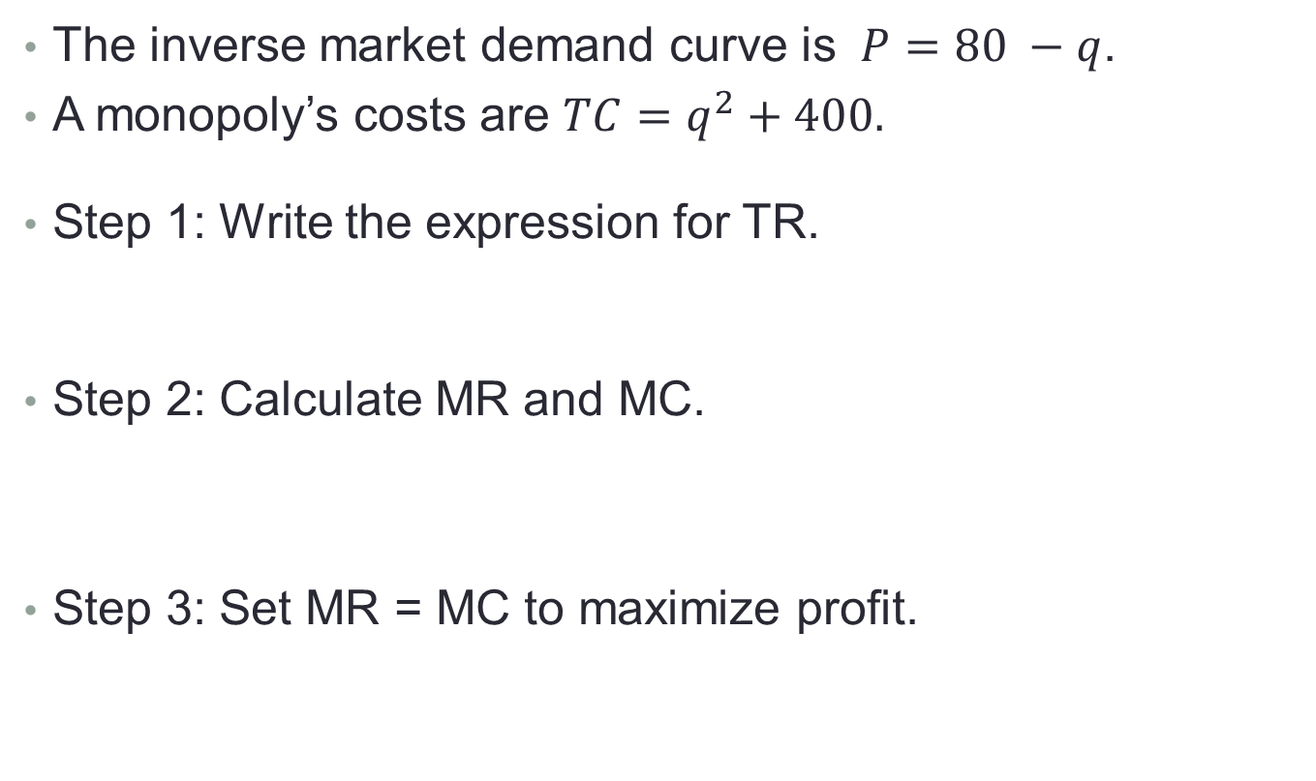
Solving the monopoly problem
The inverse market demand curve is $P=80 −q$.
A monopoly’s costs are $TC=q^{2}+400.$
Step 1: Write the expression for TR.
Step 2: Calculate MR and MC.
Step 3: Set MR = MC to maximize profit.
Notes:
MR = 80-2Q, MC = 2Q, → Q = 20

Slide 19
What value of q will maximize the monopolist’s profits?
Q = 80
Q = 60
Q = 40
Q = 20
Something else / I don’t know.
9:00 – 10:20 (100B – A): https://join.iclicker.com/HTCC
1:40 – 3:00 (100B – B): https://join.iclicker.com/MZWB

Slide 20
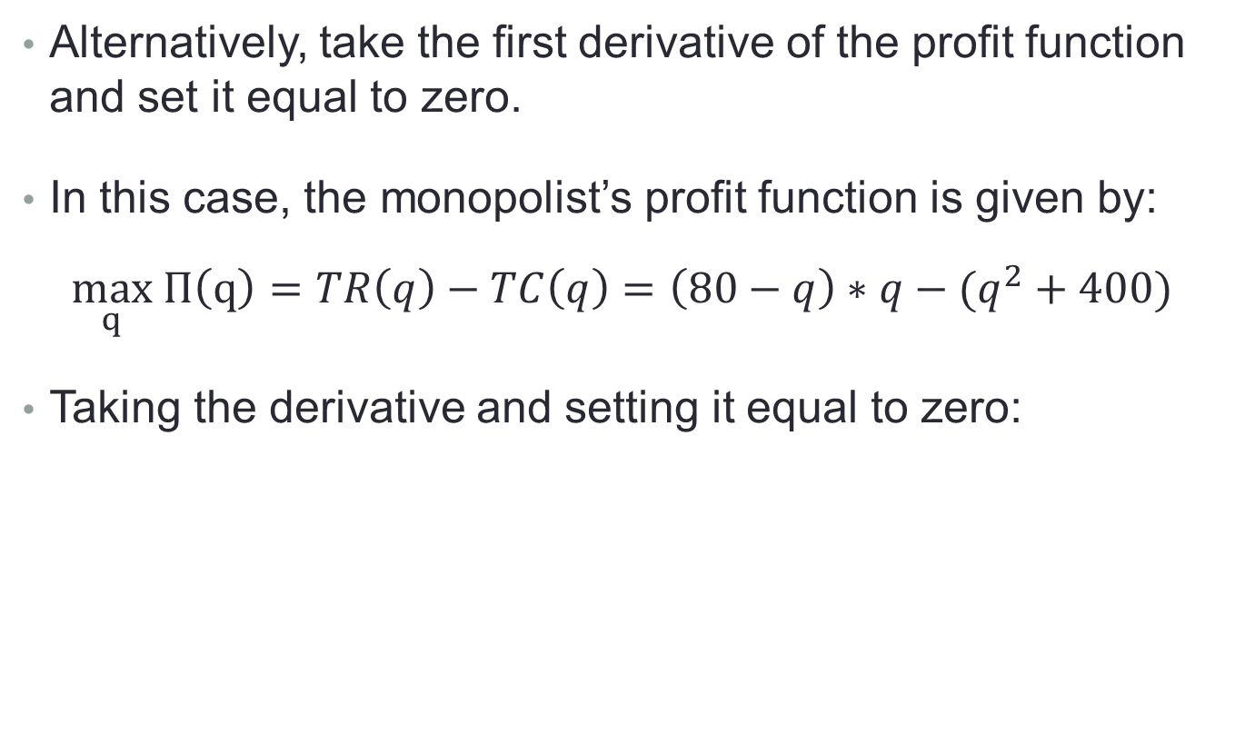
Solving the monopoly problem
Alternatively, take the first derivative of the profit function and set it equal to zero.
In this case, the monopolist’s profit function is given by:
$$\max_{q} Π\left(q\right)=TR\left(q\right)−TC\left(q\right)=\left(80−q\right)∗q−(q^{2}+400)$$
Taking the derivative and setting it equal to zero:

Slide 21
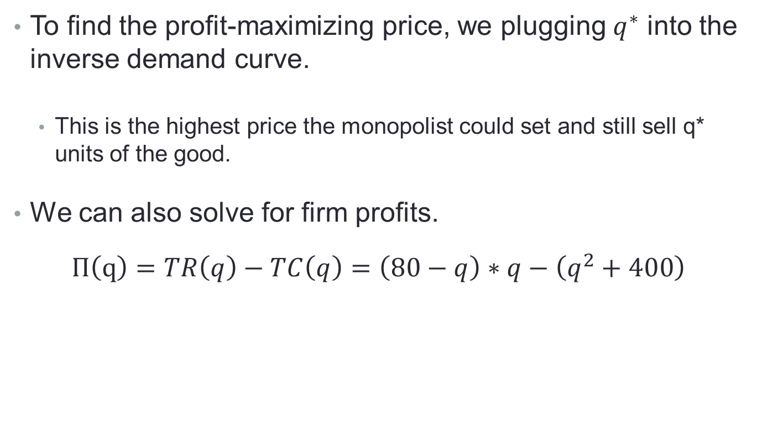
What price will the monopolist set and does the monopoly earn profits?
To find the profit-maximizing price, we plugging $q^{∗}$ into the inverse demand curve.
This is the highest price the monopolist could set and still sell q* units of the good.
We can also solve for firm profits.
$$Π\left(q\right)=TR\left(q\right)−TC\left(q\right)=\left(80−q\right)∗q−\left(q^{2}+400\right)$$
Notes:
P = 80 – q implied P = 60.
TR = 1200, TC = 800, Profit = 400.

Slide 22
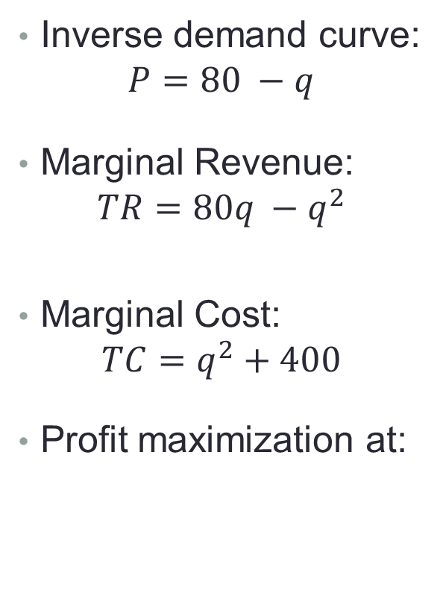
Graphical depiction of a monopoly
Inverse demand curve:
$$P=80 −q$$
Marginal Revenue:
$$TR=80q −q^{2}$$
Marginal Cost:
$$TC=q^{2}+400$$
Profit maximization at:
P
Q

Slide 23
One slick trick to keep in mind…
In the previous example, you might have noticed that the MR curve:
Has the same intercept as the inverse demand curve,
Has twice the slope of the inverse demand curve.
This is true for any linear inverse demand curve.
For instance, if demand is: P = 548 – 11Q → MR = 548 – 22Q
Notes:
Why does this work, you ask? P = a – bQ. TR = aQ-bQ*Q, MR = a – 2bQ

Slide 24
III. Monopoly and welfare (Perloff 11.2)

Slide 25
Will consumer and producer surplus be different under a monopoly than perfect competition?
No. They will be the same.
Yes. CS will be higher and PS will be lower.
Yes. CS will be lower and PS will be higher.
Yes. Both CS and PS will be lower.
I don’t know.

Slide 26
Will welfare be different under a monopoly than perfect competition?
Yes. It will be higher.
No. It will be the same.
Yes. It will be lower.
It depends.
I don’t know.

Slide 27



Let’s revisit the example from last class.
In the last class, we had a perfectly competitive market with identical supply and demand
$CS=\$900, PS=\$900$
Market
Inverse supply curve:
$$P=\frac{1}{50}Q_{s}$$
P
12
CS
6
PS
Inverse demand curve:
$$P=12 −\frac{1}{50}Q_{D}$$
0
Q=300
Q

Slide 28


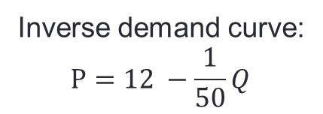
What would the diagram look like for the monopoly?
Monopoly
P
12
$$MC=\frac{1}{50}Q$$
Inverse demand curve:
$$P=12 −\frac{1}{50}Q$$
0
Q

Slide 29

Monopoly and Welfare
The monopoly has two effects on welfare.
It has created a DWL triangle (in gray) since demand is greater than MC for Q between 200 and 300.
It has captured surplus from the consumers (A) with higher valuations.
Monopoly
P
12
$$MC$$
8
A
6
4
D
MR
0
200 300
Q

Slide 30
Major takeaways
Monopolies arise for a variety of reasons, some of which are good from a societal perspective and some of which are bad.
Like PC firms, monopolies also set MR = MC to maximize profits.
But, monopolies are not price-takers. They face a downward sloping demand curve and a downward sloping MR curve.
Consequently, a profit maximizing monopoly will cut output below the competitive level and raise price.
From a welfare perspective, cutting output below the competitive level creates a DWL triangle. But, it also transfers surplus from consumers to producers.

Slide 31
Action Items
The first weekly quiz is tomorrow. You can do it from 12am – 11:59pm, but if you want the full 10 minutes, you need to start it by 11:49pm…
The first problem set is posted. You can find it on Canvas under Files → Problem Sets. It is due next Tuesday at the start of class. Please submit it on Canvas.
The textbook is available under Bookshelf on Canvas. Next class, we will cover Perloff 11.3 – 11.5.

